Slide 1

IMAGE PROCESSING IN PRACTICE
AUTOMATED TEST SCORING (BUBBLE TEST)

Slide 2
What The Project is About
Automated scoring means using machines to evaluate things typically evaluated by people. Hence the name contains the keyword ‘automated’, which means usage of computers or other machines. It is helpful in providing feedback along with the results shown, for example giving you a pass or fail grade or even a percentage at the end of the test.
In this project, we have done automated test scoring using the ‘bubble test’ method. So here, when we run the program, we have a solver image, the correct answer image, original image and the answer image.
The program checks one by one if the answer matches the correct answer and gives you a pass grade if you have 50% or more and a fail grade if you have less than 50% of the matching boxes correct. The correct answer is denoted by the blue outline box where you can check all the correct answers and compare the solution.

Slide 3
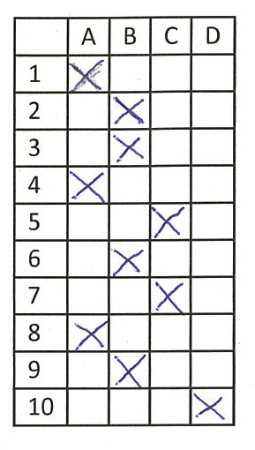
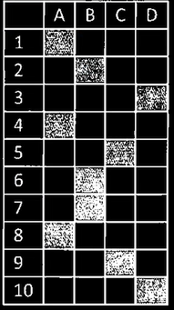
Brief Explanation of the code
Rotating the Image
First off, there are 2 images which are not equally aligned, so we align them with the X and Y axis by rotating them as required. We have used a parameter ‘r’ and tested it with the point of centre. Here, ‘const Mat & img’ is the input and ‘Mat & dest’ is the output. The warpAffine() function is the size of the output image, which should be in the form of width and height, so that we finally get corrected image.
Cropping the image
There are white spaces in the images, so to eliminate them, we crop the images a little bit, which also makes our image black and white. Here, 130 is the value of threshold.
Original image with white spaces
Cropped image, black and white

Slide 4
Making the Images Smooth and capturing the contours
In the image, there is noise, so we use the median blur method to eliminate the noises and make the image smooth.
Now , we capture the contours and we find all the contours using the ‘findContours’ keyword. Here, we find the external contours using ‘RETR_EXTERNAL’ argument and ‘CHAIN_APPROX_NONE’, which stores absolutely all the contour points.
Also, we use the minAreaRect function to get a RotatedRect around the 0th contour. The 0th contour basically means that’s we are capturing the parent contour. Contours[0] = parent contour.
Rotating the images
Now, we rotate both the original image and the prepared image using the rotateTest function that we had used before.

Slide 5
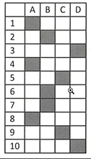
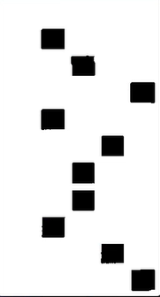
Creating the Mask of Non-Grey Cells
Now, we have to create a mask of the non-grey cells that are present in the image. To do this, we use the inRange function to select the grey cells on the image.
Next, we use the medianBlur method to smoothen the image.
We also use the erode operator to erode specific part of the image by using specific structuring of the image. Here, we have used the ‘MORPH_ELLIPSE’ argument as the structuring element.
When we invert this image, we get only the grey cells as shown in the picture below:
Inverting the image and only getting grey cells
Grey boxes of the image

Slide 6
The Main() Function
Finally, we are at the main function. Here, the first thing we do is read the ‘test_solver.png’ image in grayscale format. Also, we store it in the variable ‘solver0’.
Next, we standardise the image, that is, we crop and rotate the image. If the image doesn’t need to be rotated, we just crop it.
Now, we create the mask of non-grey cells and when we output the image to the solver, it will be a cropped version containing only black cells and no white edges.
Next, we make a for loop to read the images in grayscale. Then, we standardise the image, and if it is already rotated, then we just crop it. After its cropped, we store it in ‘img’.
The next thing to do is compare the size of ‘test_solver’ and ‘img’ using the ‘INTER_NEAREST’ function and they should be same, that’s why we used the ‘nongray.size()’ to make it the same. Then, we store the image in ‘tmp’.

Slide 7
Now, we threshold the resulting image to get the X-es and the lines. The value of threshold will be 150, then we invert the result.
The most important part will be the ‘thimg.setTo(0,nongray)’ function, as this is the one that works to check the answers, if its correct or not. It basically keeps the correct answers and removes everything else.
Implementing the Programme
Finally, we turn towards implementing our programme step by step.
The ‘imshow’ functions show the correct answer, the one with blue box one by one and it also shows the solver.
Now, we find the contours of X-es, wherever they are present, since we want to draw a rectangle wherever the ‘X’ exists.
Next, we want to show the image with blue boxes, so we store the image in ‘canvas’ using the ‘cvtColor’, which will convert the image from one color space to another.

Slide 8
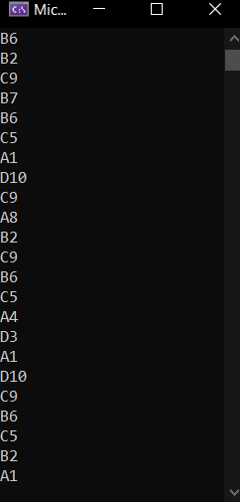
Visualising The Result
Now, we have three elements in the index : 255, 0 and 0. To iterate over the contours, we use a for loop where we also find the bounding box of ‘c’. So, when the for loop runs, first the value of ‘c’ will be 255, then 0 and lastly, 0 again. After finding the bounding box of white ‘X’, we draw the blue rectangle onto the canvas using “rectangle(canvas, r, Scalar(255, 0, 0), 3)” line of code. Here, the scalar gives : BGR values of blue, 0 value of green and 0 value for red; and 3 is the thickness of rectangle.
In the result, we require the columns and rows and hence it is coded in the programme, Basically, we are getting the coordinates of the cells, which are is displayed in the console window when the programme is executed.
Console window showing the coordinates of cells in each test case

Slide 9
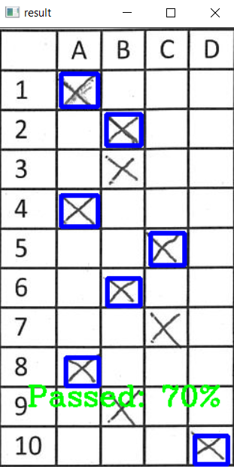
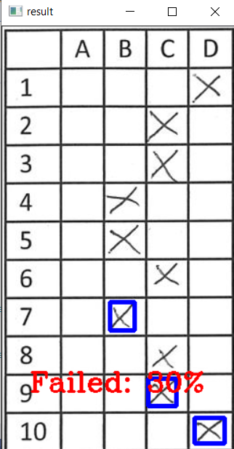
Calculating the Score and Finishing the Programme
Now, we have to calculate the score based on how many answers are correct and we also give the pass or fail mark accordingly.The ‘canvas.clone()’ is used to copy the image from canvas to show it in the result, after we count all the blue boxes.
Finally, we show the image and put the text of suitable colour on it accordingly:
a). If the percentage of correct answers is equal to or more than 50, we show the result “Passed” with the color green. For getting green, the values used are 0,255,0; so 0 values for blue, BGR values for green, 0 for red.
b). If the percentage of correct answers is less than 50, we show the result “Failed”, with the colour red. For getting red, the values used are 0,0,255; so 0 values for blue, 0 value for green and BGR for red.
Result with 70%
“Passed” Grade
Result with 30% “Failed” Grade

